Slide 1
Operating systems
Mutex, Semaphore

Slide 2
Content Lecture#9
01
Mutex
02
Semaphore
03
C
04
S
05
I

Slide 3

Lets take a Break
A programmer had a problem, so he used threads. Then he had two problems.

Slide 4
Mutex Locks
The hardware-based solutions to the critical-section problem
Semaphore
In 1965, Dijkstra (Dutch Scientist) invented synchronize variable that takes non negative integer variable

Slide 6
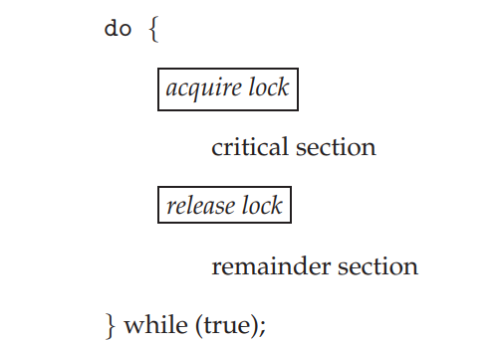
Mutex Locks
The hardware-based solutions to the critical-section problem
  are complicated.
  inaccessible to application programmers.
Operating-systems designers build software tools called mutex lock.
mutex lock to protect critical regions and thus prevent race conditions.
Process must acquire the lock before entering a critical section. “acquire()” function
Process releases the lock when it exits the critical section. “release()” function
acquire()
{
while (!available) ;
/* busy wait */
available = false;;
}
Critical section solution using mutex lock
release()
{
available = true;
}
A mutex lock has a boolean variable available whose value indicates if the lock is available or not. If the lock is available, a call to acquire() succeeds, and the lock is then considered unavailable. A process that attempts to acquire an unavailable lock is blocked until the lock is released. The definition of acquire() is as follows:
* Calls to either acquire() or release() must be performed atomically

Slide 7
Semaphores
In 1965, Dijkstra (Dutch Scientist) invented synchronize variable that takes non negative integer variable
A semaphore has two operations
  Wait (P)
    An atomic operation that waits for semaphore to become positive, then decrements its by 1
  Signal (V)
    An atomic operation that increments semaphore by 1 after completing operation and releasing semaphore
Entry to critical sections of active processes is controlled by the P operation and exit is controlled by V operation
A semaphore such as S, indicates the availability of some resource;
  If it has a non-zero positive value, it is available
  If it is zero, it is unavailable, i.e. it is being accessed by another process

Slide 8
Semaphore
The wait operation allows a process to access a resource (S>0) or may cause the process to be blocked
The signal operation signals that some process has released resource and now it can be used by a process waiting for it
These operations are used to bracket the critical sections of the process;
  wait(S)
  <critical section>
  signal(S)
Assume S is initially set to value 1 (resource is available)
  The first process to execute the wait will set S to S-1 and will enter to its critical section
  If another process reaches its critical section, the wait now finds S set to 0 and process is blocked
  When first process is exit from its critical section, it executes the signal, S would set to 1

Slide 9
Semaphore
For each semaphore, the system must maintain a queue of waiting processes
The semaphore operations are implemented as OS services
The OS will guarantee that wait and signal are invisible
  i.e. once started they cannot be interrupted
The semaphore with values 1 or 0 are termed as binary semaphore
Counting semaphore may have any non-negative value
  The value indicate the available quantity of a particular resource type

Slide 10
Semaphore Properties
Attractive Properties
  Machine independent
  Simple
  Work with many
  For more critical section use different semaphores
  Acquire many resources simultaneously
  Permit multiple processes into critical section at once if desirable
Limits of semaphores
  Semaphores are not provided by hardware
  Programmers must use them correctly
  Cannot test busy without blocking
  Indefinite blocking

Slide 11
Semaphore-Examples
Producer Consumer problem
  A producer process generates data and store them in the next available buffer in array
  Process consumer is removing items from buffer and processing them
  Assume number of positions in the buffer is finite, say N
  A particular example is print routine, which is sending characters to a printer driver for printing
  We need to protect buffer since both process can access it
  The additional problems are;
    The producer must wait for an empty space if buffer is full
    The consumer must wait for data available if buffer is empty

Slide 12
Semaphores : Producer Consumer
Semaphore | Purpose | Initial value
Free Space Data | Mutual exclusion for buffer access Space available in buffer Data available in buffer | 1 N 0
Producer | Explanation
Produce item wait(space) wait(free) add item to buffer signal(free) signal(data) | Application produces data item If buffer full, wait for space signal If buffer being used, wait for free signal Put item in next buffer slot Signal that buffer no longer in use Signal that data has been put in buffer

Slide 13
Semaphores : Producer Consumer
Consumer | Explanation
wait(data) wait(free) get item from buffer signal(free) Signal(space) Consume item | Wait until at least one item in buffer If buffer being used, wait for free signal Get item from buffer Signal that buffer no longer in use Signal that at least one space exist in buffer Application specific processing of item
The counting semaphore data and space are also used as counters to monitor the occupancy of buffer
Wait and signal operations decrement and increment these counters
The producer’s signal (data) will increment the count of the number of data item

Slide 14
Semaphore: Unix
Unix provide facility for creation and handling of semaphores
The semget function call is used in a program to create semaphore variables, it creates an array of semaphores
The semget call specifies
  The number of semaphores required
  A unique key value to identify semaphore
  Some access and control information
The function call semctrl provides a range of semaphore maintenance services; such as
  Examining the value of a semaphore
  Removing a semaphore set, and
  Initializing the semaphore
The detailed processing of the semaphore is carried out by semop function call

Slide 15
Semaphore vs Mutex
Parameters | Semaphore | Mutex
Mechanism | It is a type of signaling mechanism. | It is a locking mechanism.
Data Type | Semaphore is an integer variable. | Mutex is just an object.
Modification | The wait and signal operations can modify a semaphore. | It is modified only by the process that may request or release a resource.
Resource management | If no resource is free, then the process requires a resource that should execute wait operation. It should wait until the count of the semaphore is greater than 0. | If it is locked, the process has to wait. The process should be kept in a queue. This needs to be accessed only when the mutex is unlocked.
Thread | You can have multiple program threads. | You can have multiple program threads in mutex but not simultaneously.
Ownership | Value can be changed by any process releasing or obtaining the resource. | Object lock is released only by the process, which has obtained the lock on it.
Types | Types of Semaphore are counting semaphore and binary semaphore. | Mutex has no subtypes.
Operation | Semaphore value is modified using wait () and signal () operation. | Mutex object is locked or unlocked.
Resources Occupancy | It is occupied if all resources are being used and the process requesting for resource performs wait () operation and blocks itself until semaphore count becomes >1. | In case if the object is already locked, the process requesting resources waits and is queued by the system before lock is released.

Slide 16
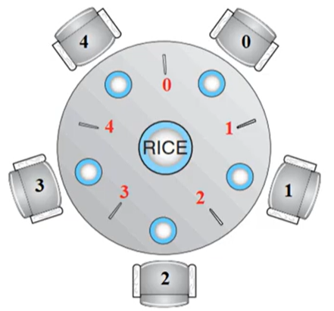
Dining Philosophers Problem
Philosophers spend their lives thinking and eating
Don’t interact with their neighbors, occasionally try to pick up 2 chopsticks (one at a time) to eat from bowl
  Need both to eat, then release both when done
In the case of 5 philosophers
  Shared data
    Bowl of rice (data set)
    Semaphore chopstick [5]

Slide 17
Semaphores
A semaphore S is an integer variable that, apart from initialization, is accessed only through two standard atomic operations:
  wait() “to test”
  signal() “to increment”
wait(S)
{
while (S <= 0) ;
// busy wait S- -;
}
signal(S)
{
S++;
}
All modifications to the integer value of the semaphore in the wait() and signal() operations must be executed indivisibly. That is, when one process modifies the semaphore value, no other process can simultaneously modify that same semaphore value.
definition of wait()
definition of signal()

Slide 18
Mutex vs Semaphore
Mutex used for mutual exclusion
acquire(&Lock0);
release(&Lock);
Semaphore
Wait(&Lock0);
signal(&Lock);
Binary semaphore lock=1 mutex lock
Counting semaphore lock=1,2,3,…N

Slide 19
Mutex & Semaphore
data;
mutex = 1;
read()
{
acquire(&mutex); or wait(&mutex);
cout<<data;
release (&mutex) or simple signal(&mutex);
}
write()
{
acquire(&mutex); or wait(&mutex);
data=getdata();
release (&mutex) or simple signal(&mutex);
}

Slide 20
Reader-Writer Algorithm
multiple readers can enter in critical section
rw_mutex_lock =1;
count =0;
mutex=1
read
{
wait(&mutex);
count++;
signal(&mutex);
//--> contex switch of time slice expires
if(count==1)
write(&rw_mutex_lock);
//critical section
wait(&mutex);
count--;
signal(&mutex);
if(count==0)
signal(&rw_mutex_lock);
}
Write()
{
Wait ()&rw_mutex;
data =getdata();
signal(&rw_mutex_Lock)
}
(Reader priority and writer thread starves)
what if there are multiple readers why should they enter one by one and data is not being effected..
But read and write can not enter at the same time as read operation is shared.
Reader-Writer Algorithm -1 Reader priority and writer thread starves
Reader-Writer Algorithm -2 Writer priority and Reader thread starves
Reader-Writer Algorithm -3 Writer enter simultaneously and then readers

Slide 21
Producer-Consumer Problem
buffer =[10];
count=0; /// to chekc if there is space available in buffer
in =0; out =0; mutex=1;
producer() //sender
{
while (count--10){}
buffer [in] = getdata();
in =(in + 1)%10;
wait(&mutex);
count++;
signal(&mutex);
}
Consumer() //receiver{
while(count==0){}
cout<<buffer{out};
out = (out+1)%10;
wait(&mutex);
count--;
signal(&mutex);
}
Inter process communication is done through PIPE()
Inter thread communication is done using a buffer with any size but need to incorporate check PIPE ican be used but avoided for performance due to system call invoke
Producer only produce data where buffer has some space
If buffer is empty consumer blcok

Slide 22
Bounded Buffer problem
buffer =[10];
in =0;
out =0;
empty =10;
full =0;
producer() //sender
{
wait(&empty);
buffer [in] = getdata();
in =(in + 1)%10;
signal(&full);
}
Consumer() //receiver
{
wait(&full);
cout<<buffer{out};
out = (out+1)%10;
signal wait(&empty);
}

Slide 23
Dining Philosopher
semaphore chopstick[5];
5.8 Monitors 223
do {
wait(chopstick[i]);
wait(chopstick[(i+1) % 5]);
...
/* eat for awhile */
...
signal(chopstick[i]);
signal(chopstick[(i+1) % 5]);
...
/* think for awhile */
...
} while (true);

Slide 24
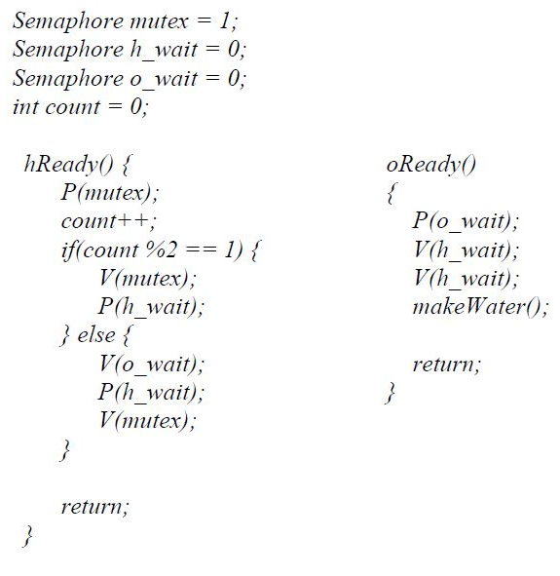
H2O
There are two kinds of threads, oxygen and hydrogen. In order to assemble these threads into water molecules, we have to create a barrier that makes each thread wait until a complete molecule is ready to proceed. As each thread passes the barrier, it should invoke bond. You must guarantee that all the threads from one molecule invoke bond before any of the threads from the next molecule do. In other words:
  • If an oxygen thread arrives at the barrier when no hydrogen threads are present, it has to wait for two hydrogen threads.
  • If a hydrogen thread arrives at the barrier when no other threads are present, it has to wait for an oxygen thread and another hydrogen thread.

Slide 25
Condition Variable
Semaphore
Semaphore, as name suggests, is basically an object that includes counter, waiting list of process and supports two different operations i.e., wait and signal. Its type includes counting semaphores and binary semaphores. It is simply a synchronization tool that can be used to deal with critical-section problem. It provides simple abstraction for controlling access to a common resource in programming environment.
Condition Variable
Condition Variable, as name suggests, is simply a synchronization primitive that allows threads to wait until particular condition occurs. It includes two operations i.e., wait and signal. It just allows thread to be signaled when something of interest to that threads occurs and is mostly used when one wants to know when something happens.

Slide 26
Condition Variable
Semaphore | Condition Variable
It does not allow threads to wait. Instead, each thread keeps running and last thread that will set semaphore value to zero will go to sleep. | It allows threads to wait until particular condition occurs.
It is generally used to solve problem of some critical sections in process synchronization. | It is generally used with mutex to signal changing states from one thread to another one.
Its main aim is to control access to common resource by multiple processes and avoid critical section problems in concurrent system like multitasking operating system. | Its main aim is to support operations that wake one or wake all waiting threads.
It can be used anywhere except in a monitor. | It can only be used in monitors.
In this, wait () does not always block its caller. | In this, wait () usually blocks its caller always.
They are sticky as they have memory and sem_post() will increment semaphore even if no one has called sem_wait(). | They are non-sticky as signal () is not saved if there is no one waiting for signal ().
It is simply a counter + mutex + wait queue. | It is simply a wait-queue.
It can be used as a conditional variable and therefore is more lightweight and flexible. | It cannot be used as a semaphore and therefore is not flexible.
In this, we cannot unlock all waiting threads in same instant using broadcast unlocking. | In this, we can unlock all waiting threads in same instant using broadcast unlocking.
Signals are not lost even if there is nobody waiting on the queue. | Signals are lost if there is nobody waiting on the queue.

Slide 27
Deadlock Avoidance
Requires that the system has some additional a priori information available
Simplest and most useful model requires that each process declare the maximum number of resources of each type that it may need
The deadlock-avoidance algorithm dynamically examines the resource-allocation state to ensure that there can never be a circular-wait condition
Resource-allocation state is defined by the number of available and allocated resources, and the maximum demands of the processes

Slide 28
Safe State
When a process requests an available resource, system must decide if immediate allocation leaves the system in a safe state
System is in safe state if there exists a sequence <P₁, P₂, …, P_{n}> of ALL the processes in the systems such that for each P_{i}, the resources that P_{i} can still request can be satisfied by currently available resources + resources held by all the P_{j}, with j < I
That is:
  If P_{i} resource needs are not immediately available, then P_{i} can wait until all P_{j} have finished
  When P_{j} is finished, P_{i} can obtain needed resources, execute, return allocated resources, and terminate
  When P_{i} terminates, P_{i +1} can obtain its needed resources, and so on

Slide 29
Basic Facts
If a system is in safe state ⇒ no deadlocks
If a system is in unsafe state ⇒ possibility of deadlock
Avoidance ⇒ ensure that a system will never enter an unsafe state.

Slide 30
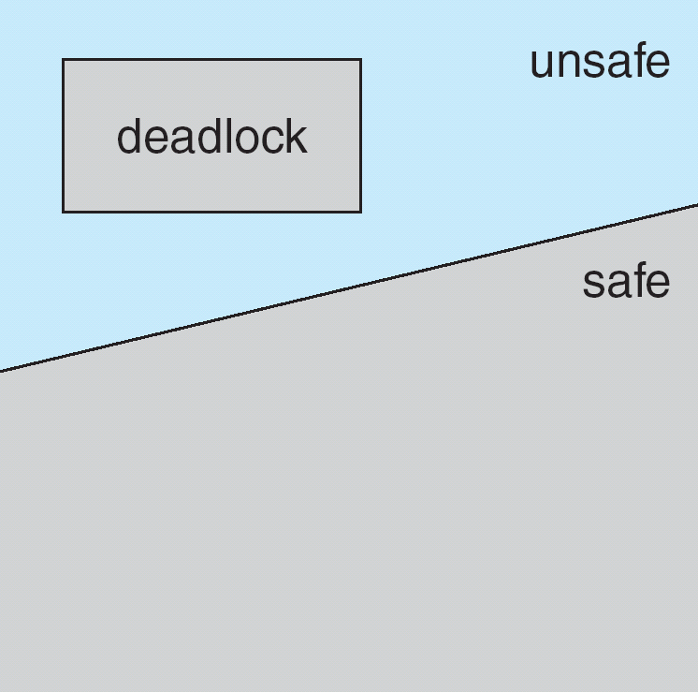
Safe, Unsafe, Deadlock State

Slide 31
Avoidance Algorithms
Single instance of a resource type
  Use a resource-allocation graph
Multiple instances of a resource type
  Use the banker’s algorithm

Slide 32
Resource-Allocation Graph Scheme
Claim edge P_{i} → R_{j} indicated that process P_{j} may request resource R_{j}; represented by a dashed line
Claim edge converts to request edge when a process requests a resource
Request edge converted to an assignment edge when the resource is allocated to the process
When a resource is released by a process, assignment edge reconverts to a claim edge
Resources must be claimed a priori in the system

Slide 33
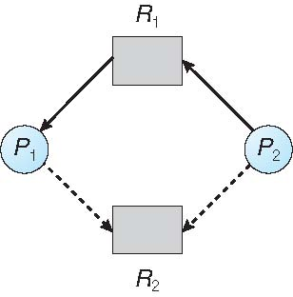
Resource-Allocation Graph

Slide 34
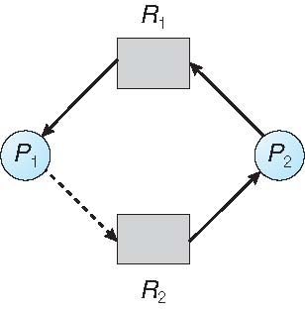
Unsafe State In Resource-Allocation Graph

Slide 35
Resource-Allocation Graph Algorithm
Suppose that process P_{i} requests a resource R_{j}
The request can be granted only if converting the request edge to an assignment edge does not result in the formation of a cycle in the resource allocation graph

Slide 36
Banker’s Algorithm
Multiple instances
Each process must a priori claim maximum use
When a process requests a resource it may have to wait
When a process gets all its resources it must return them in a finite amount of time

Slide 37
Data Structures for the Banker’s Algorithm
Let n = number of processes, and m = number of resources types.
Available: Vector of length m. If available [j] = k, there are k instances of resource type R_{j} available
Max: n x m matrix. If Max [i,j] = k, then process P_{i} may request at most k instances of resource type R_{j}
Allocation: n x m matrix. If Allocation[i,j] = k then P_{i} is currently allocated k instances of R_{j}
Need: n x m matrix. If Need[i,j] = k, then P_{i} may need k more instances of R_{j} to complete its task
    Need [i,j] = Max[i,j] – Allocation [i,j]

Slide 38
Safety Algorithm
1. Let Work and Finish be vectors of length m and n, respectively. Initialize:
      Work = Available
      Finish [i] = false for i = 0, 1, …, n- 1
2. Find an i such that both:
  (a) Finish [i] = false
  (b) Need_{i} ≤ Work
  If no such i exists, go to step 4
3. Work = Work + Allocation_{i}
Finish[i] = true
go to step 2
4. If Finish [i] == true for all i, then the system is in a safe state

Slide 39
Resource-Request Algorithm for Process P_{i}
Request_{i} = request vector for process P_{i}. If Request_{i} [j] = k then process P_{i} wants k instances of resource type R_{j}
  1. If Request_{i} ≤ Need_{i} go to step 2. Otherwise, raise error condition, since process has exceeded its maximum claim
  2. If Request_{i} ≤ Available, go to step 3. Otherwise P_{i} must wait, since resources are not available
  3. Pretend to allocate requested resources to P_{i} by modifying the state as follows:
      Available = Available – Request_{i};
      Allocation_{i} = Allocation_{i} + Request_{i};
      Need_{i} = Need_{i} – Request_{i};
    If safe ⇒ the resources are allocated to P_{i}
    If unsafe ⇒ P_{i} must wait, and the old resource-allocation state is restored

Slide 40
Example of Banker’s Algorithm
5 processes P₀ through P₄;
3 resource types:
A (10 instances), B (5instances), and C (7 instances)
Snapshot at time T₀:
Allocation Max Available
A B C A B C A B C
P₀ 0 1 0 7 5 3 3 3 2
P₁ 2 0 0 3 2 2
P₂ 3 0 2 9 0 2
P₃ 2 1 1 2 2 2
P₄ 0 0 2 4 3 3

Slide 41
Example (Cont.)
The content of the matrix Need is defined to be Max – Allocation
Need
A B C
P₀ 7 4 3
P₁ 1 2 2
P₂ 6 0 0
P₃ 0 1 1
P₄ 4 3 1
The system is in a safe state since the sequence < P₁, P₃, P₄, P₂, P₀> satisfies safety criteria

Slide 42
Example: P₁ Request (1,0,2)
Check that Request ≤ Available (that is, (1,0,2) ≤ (3,3,2) ⇒ true
Allocation Need Available
A B C A B C A B C
P₀ 0 1 0 7 4 3 2 3 0
P₁ 3 0 2 0 2 0
P₂ 3 0 2 6 0 0
P₃ 2 1 1 0 1 1
P₄ 0 0 2 4 3 1
Executing safety algorithm shows that sequence < P₁, P₃, P₄, P₀, P₂> satisfies safety requirement
Can request for (3,3,0) by P₄ be granted?
Can request for (0,2,0) by P₀ be granted?

Slide 43
Thank you

